Slide 1
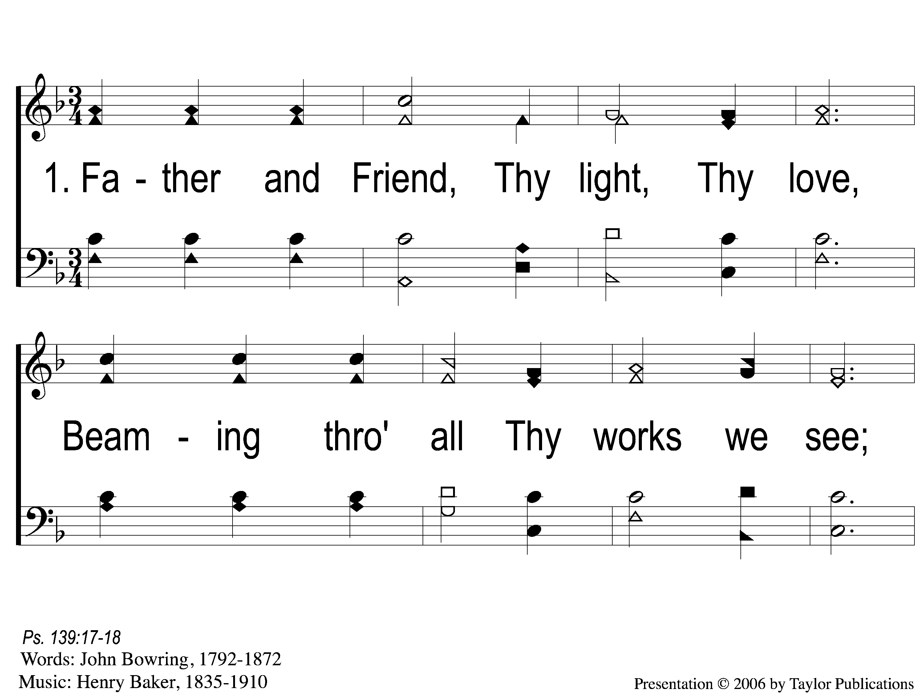
1-1 Father and Friend
Father And Friend
103

Slide 2
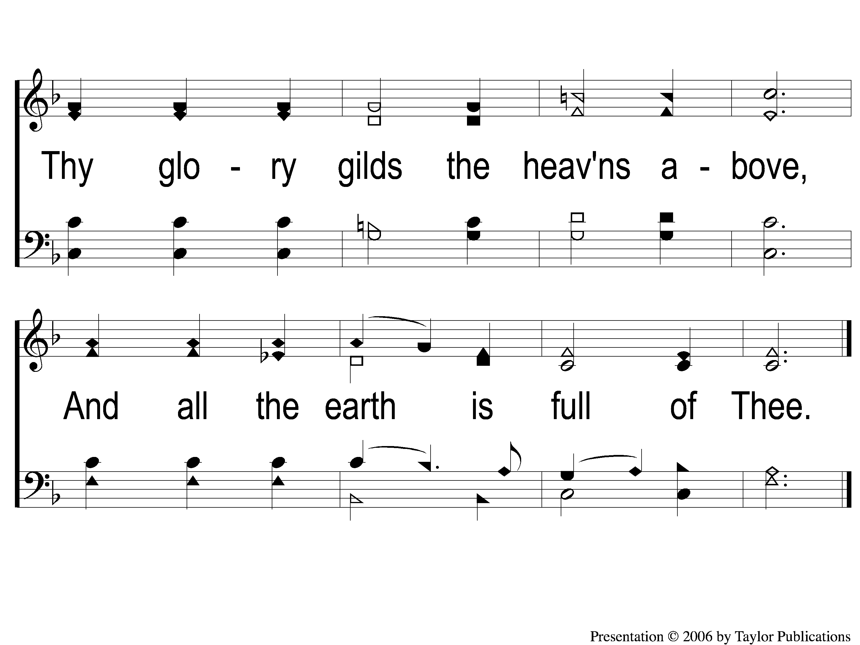
1-2 Father and Friend
Father And Friend
103

Slide 3
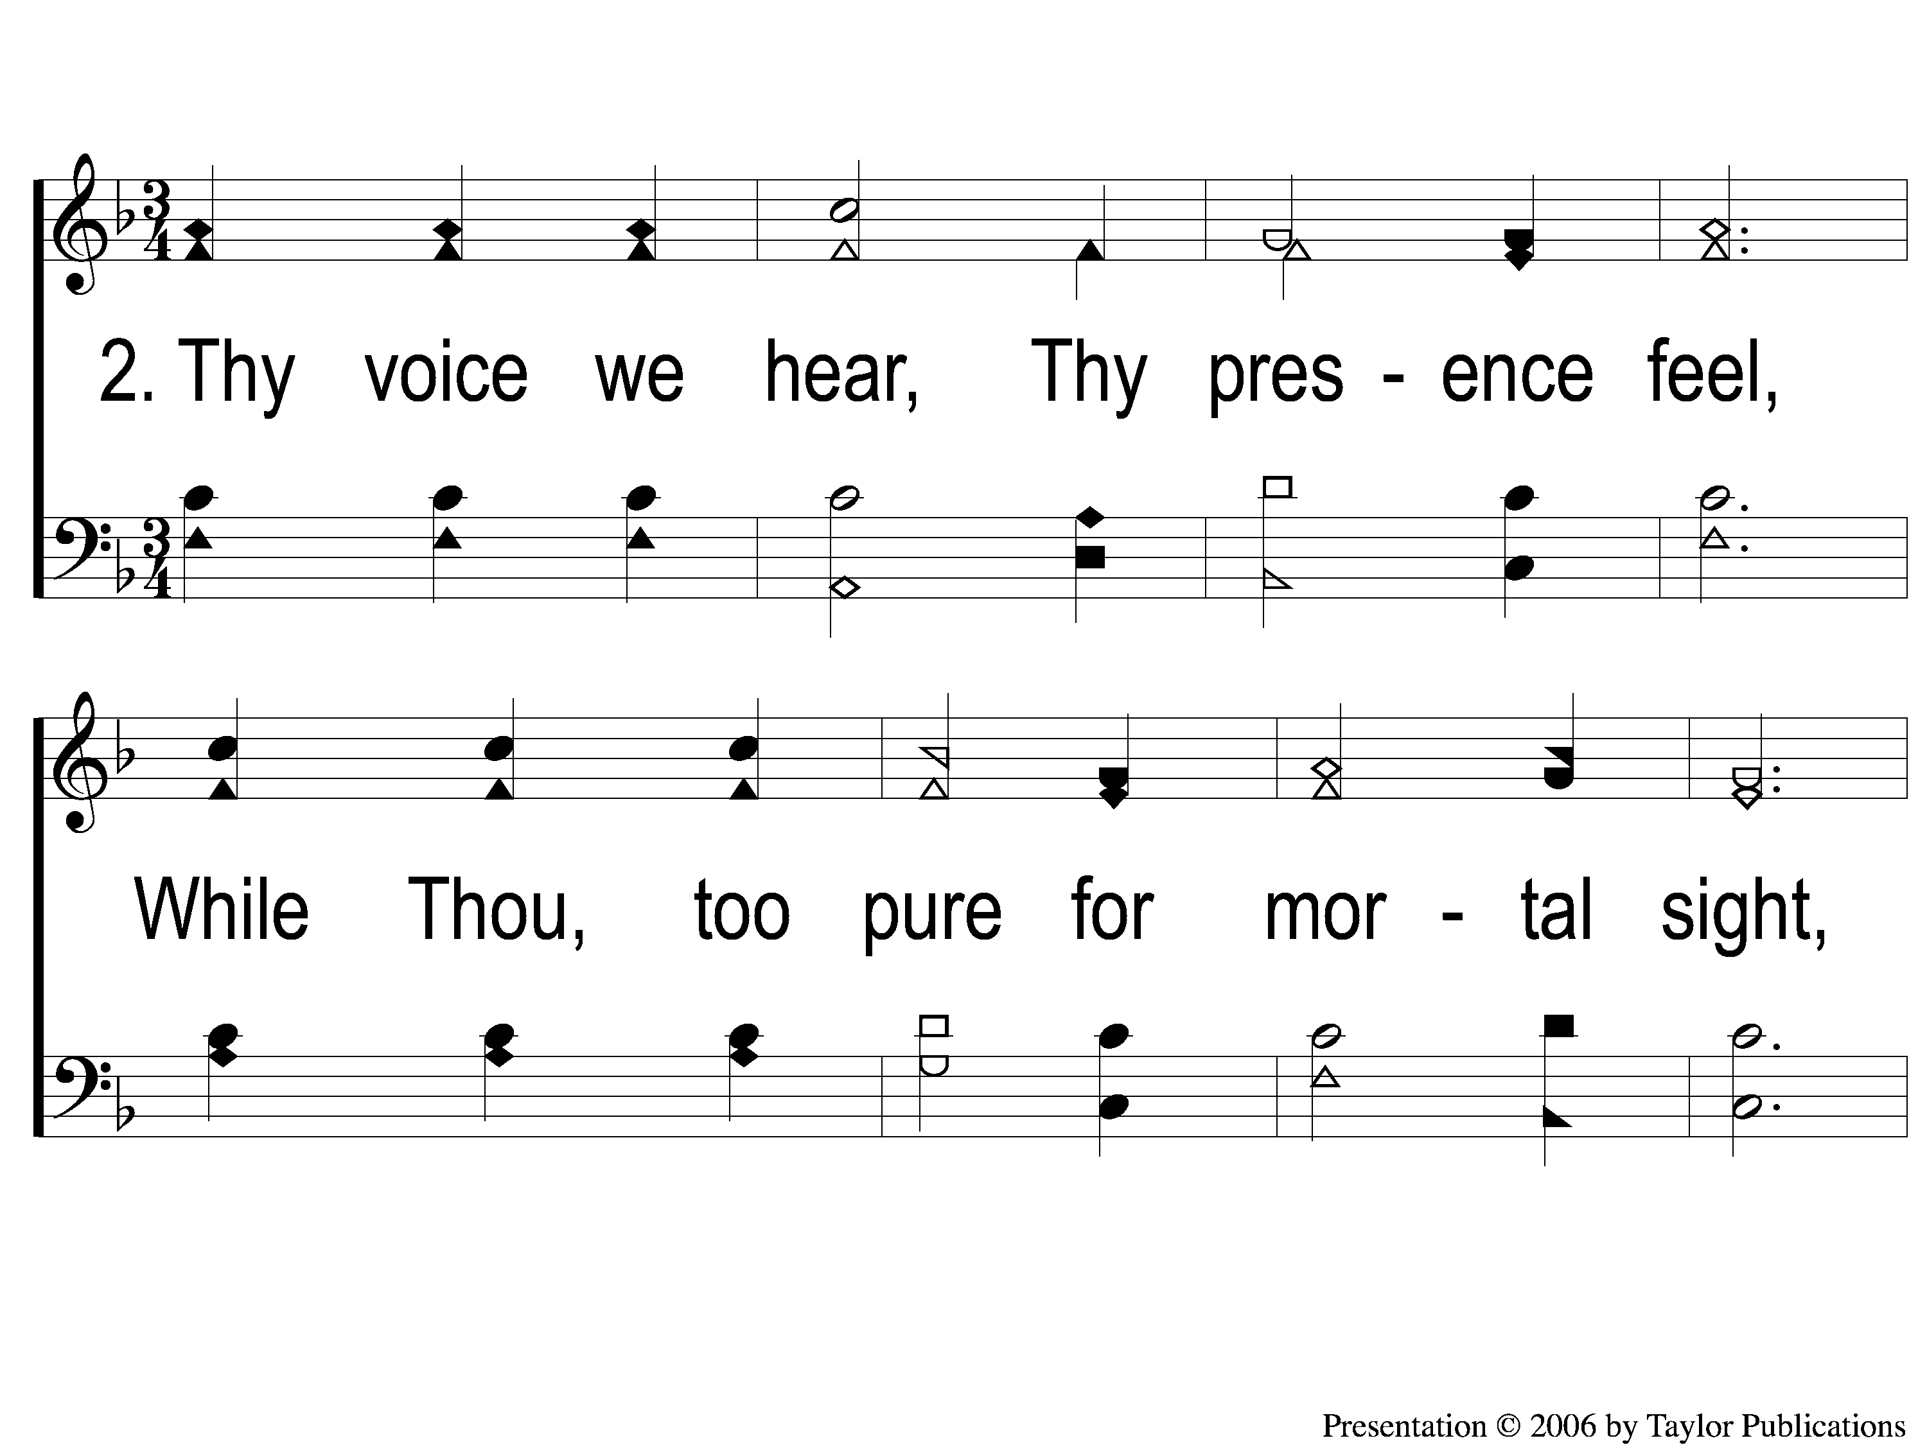
2-1 Father and Friend
Father And Friend
103

Slide 4
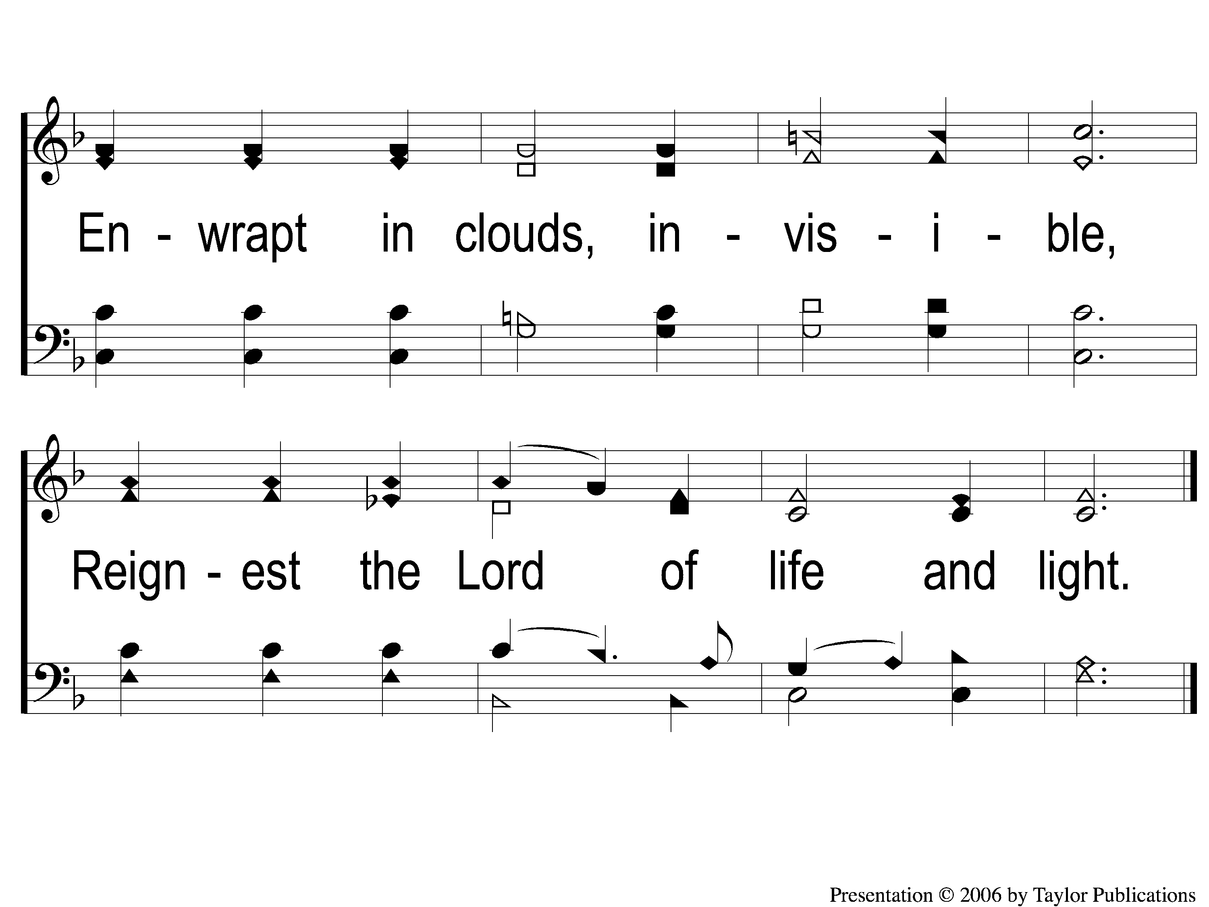
2-2 Father and Friend
Father And Friend
103

Slide 5
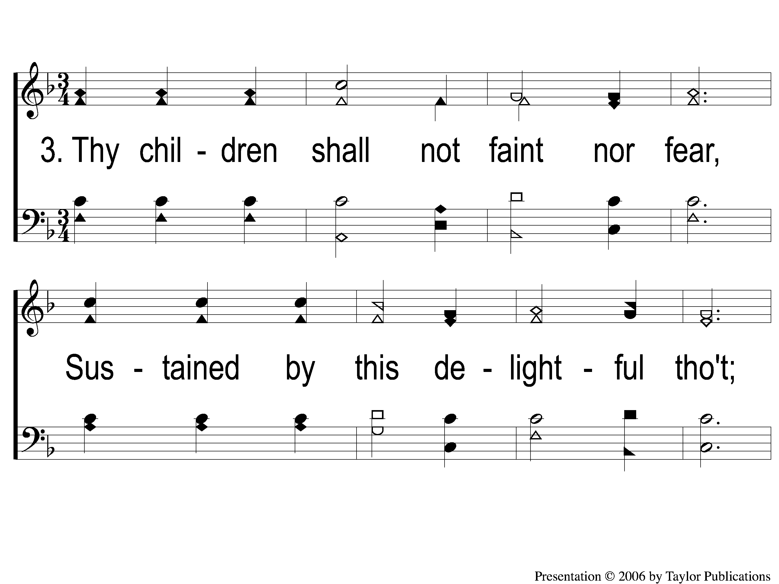
3-1 Father and Friend
Father And Friend
103

Slide 6
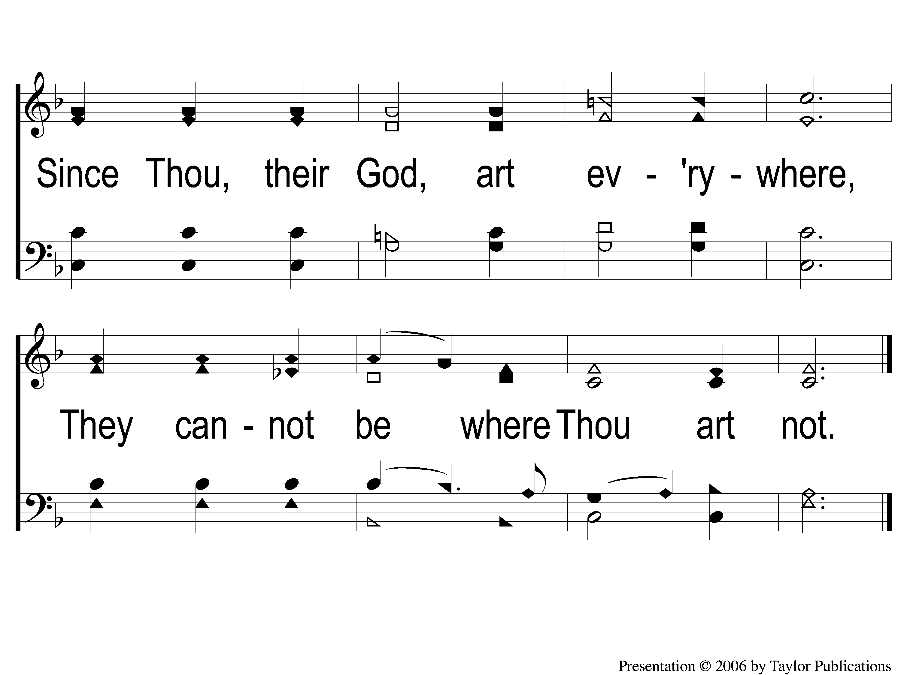
3-2 Father and Friend
Father And Friend
103

